Slide 2
PROBABILITY

Slide 3

Chance of happening an event
Probability =$\frac{number of favourable events}{number of total events}$

Slide 4
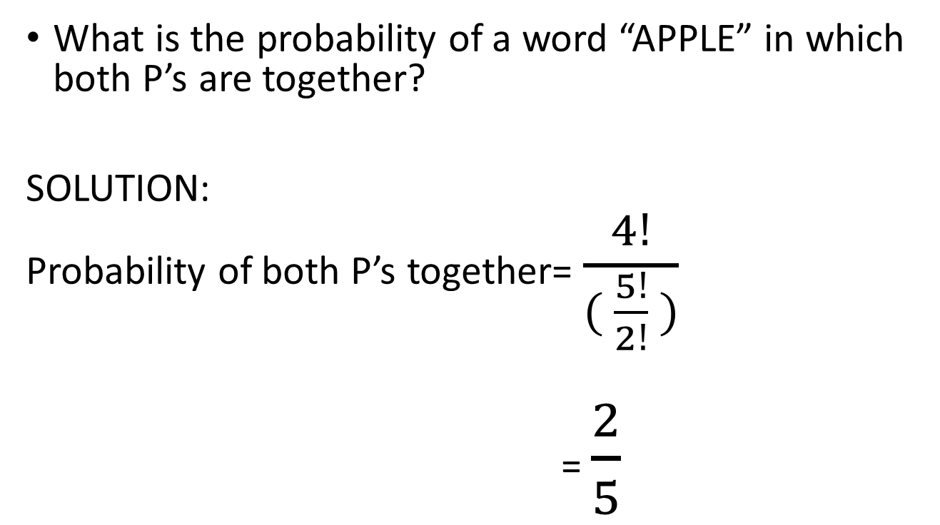
Example 1
What is the probability of a word “APPLE” in which both P’s are together?
SOLUTION:
Probability of both P’s together= $\frac{4!}{( \frac{5!}{2!} )}$
= $\frac{2}{5}$

Slide 5
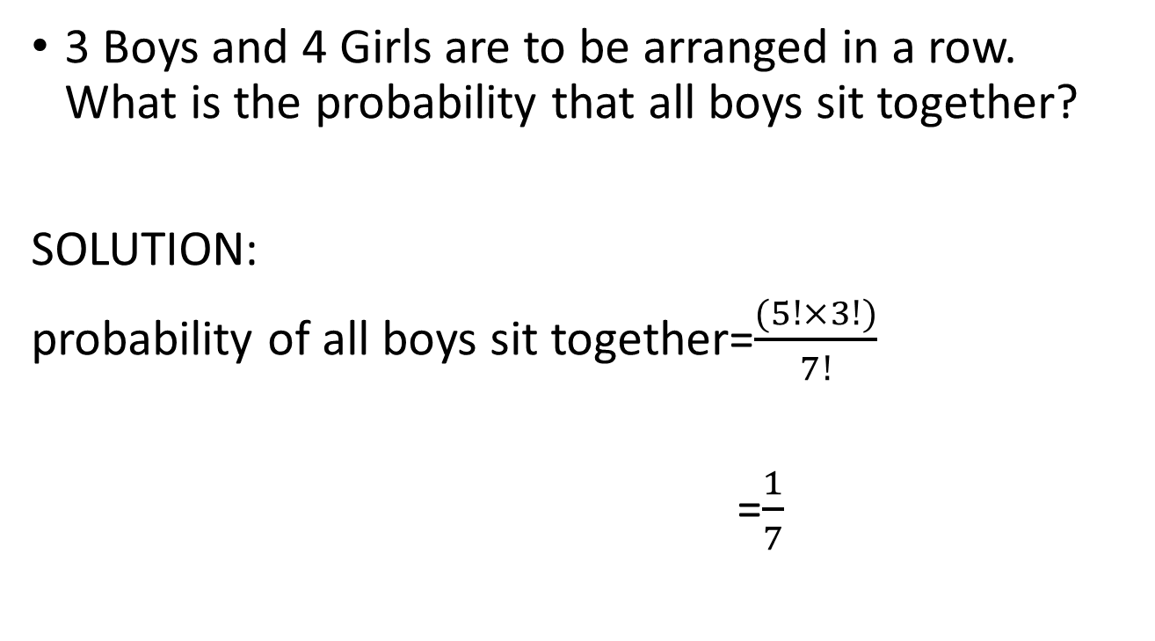
Example 2
3 Boys and 4 Girls are to be arranged in a row. What is the probability that all boys sit together?
SOLUTION:
probability of all boys sit together=$\frac{(5!×3!)}{7!}$
=$\frac{1}{7}$

Slide 6
SPECIFIC TERMS
Sample space => Total possible outcomes
Biased Event => Assumption
Unbiased Event => Normal

Slide 7
DICE
1 Dice => 6
2 Dice => 36
3 Dice => 216
4 Dice =>1296

Slide 8
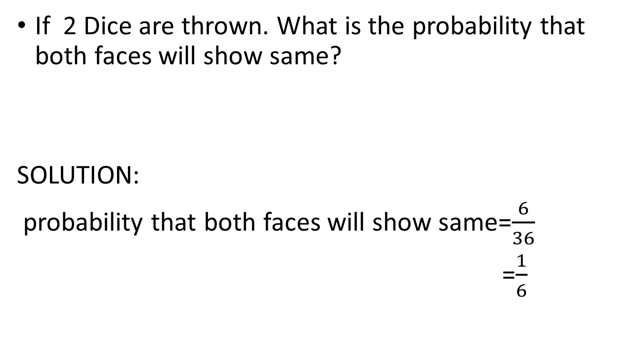
EXAMPLE 1
If 2 Dice are thrown. What is the probability that both faces will show same?
SOLUTION:
probability that both faces will show same=$\frac{6}{36}$
=$\frac{1}{6}$

Slide 9
EXAMPLE 2
If 2 Dice are thrown, What is the probability of sum on faces is less than equal to 4?
SOLUTION:
The sum can be either 2(1,1) or 3 (1,2) (2,1) or 4(1,3)(2,2)(3,1)
Probability of sum on faces is
less than equal to 4= 6/36
=1/6

Slide 10
EXAMPLE 3
If 3 Dice are thrown, What is the probability of sum on faces is to be 15?
SOLUTION:
Possibilities = (5,5,5) = 1
(4,5,6) =3! =6
(3,6,6) = 3!/2! = 3
probability of sum on faces is to be 15 = 10/216

Slide 11
EXAMPLE 4
If 4 Dice are thrown, What is the probability of sum on faces is to be 20?
SOLUTION:
Possibilities=(6,6,6,2) = 4!/3! = 4
(6,6,5,3) = 4!/2! = 12
(6,6,4,4) = 4!/(2!*2!) = 6
(6,5,5,4) = 4!/2! = 12
(5,5,5,5) = 1
probability of sum on faces is to be 20 =35/1296

Slide 12
COINS
1 Coin = H, T
2 Coins = HH,HT,TH,TT
3 Coins =HHH,HHT,HTH,THH,TTT,TTH,THT,HTT

Slide 13
EXAMPLE 1
If 3 coins are thrown, What is the probability of exactly getting 2 heads?
SOLUTION:
probability of exactly getting 2 heads=3/8

Slide 14
CARDS
Honored cards =A,K,Q,J (16 Cards)
Face cards = K,Q,J (12 Cards)

Slide 15
Example 1
When 2 cards are drawn, What is the probability that both cards are king?
SOLUTION:
probability that both cards are king = 4C2/52C2

Slide 16
Types of question
Cards drawn at random
Cards drawn one by one
Cards drawn one by one by replacement

Slide 17
Example 2
When 2 cards are drawn one by one and one by one with replacement ,What is the probability that both are diamonds?
SOLUTION:
Cards drawn one by one = (13/52)*(12/51)
Cards drawn one by one
with replacement = (13/52)*(13/52)

Slide 18
Example 3
From a pack 52 cards,4 cards are drawn at random and one by one,such that they are with different suits and different number of faces.
SOLUTION:
Cards drawn at random = (52*36* 22*10)/52C4
Cards drawn one by one =
(52/52) *(36/51)*(22/50)*(10/49)

Slide 19
IMPORTANT TERMS
Mutually Exclusive => Nothing is common
Non-Mutually Exclusive => something is common
P(A or B)= P(A)+P(B) - P(A and B)

Slide 20
Example 4
From a pack of card,1 card is drawn,find the probability that it is red or king?
SOLUTION:
Let A= Probability of red
B= Probability of king
P(A or B) = P(A) + P(B) – P(A and B)
= (26/52) + (4/52) – (2/52)
=(28/52)
= (7/13)

Slide 21
From a pack of card,1 card is drawn,find the probability that it is spade or Diamond?
SOLUTION:
Let A= Probability of spade
B= Probability of Diamond
P(A or B) = P(A) + P(B) – P(A and B)
=(13/52) + (13/52) – 0
= (26/52) =1/2

Slide 22
INDEPENDENT EVENT
Will not be a factor of other event
P(AnB)= P(A) * P(B)

Slide 23
Example
When a dice and a coin is thrown,What is the probability of getting even number of Dice and head on the coin?
SOLUTION:
P(AnB)= P(A) * P(B)
P(Even number) = 3/6
P( head) =1/2
P(A n B) =(3/6) * (1/2) = (1/4)

Slide 24
DEPENDENT EVENT
Will be a factor of other event

Slide 25
Example
Urn 1 contains 4 Red balls and 5 Blue balls
Urn 2 contains 3 Red balls and 6 Blue balls
If 1 ball is drawn from Urn 1 and put into Urn 2.Now if 1 ball is drawn from Urn 2.What is the probability
that it is Red?

Slide 26
SOLUTION:
Possible cases=RR+BR
= [(4/9)*(4/10)] + [(5/9)*(3/10)]
=(16/90) + (15/90)
= 31/90

Slide 27
Example
Urn 1 contains 4 Red balls and 5 Blue balls
Urn 2 contains 3 Red balls and 6 Blue balls
If 2 ball is drawn from Urn 1 and put into Urn 2.Now if 1 ball is drawn from Urn 2.What is the probability
that it is Red?

Slide 28
SOLUTION:
Possibilities = RRR+BBR+RBR
=[(4C2/9C2)*(5/11)]+[(5C2/9C2)*(3/11)]+
[((4C1*5C1)/9C2)*(4/11)]
=[(6/36) * (5/11)] + [(10/36)*(3/11)]+[(80/(36*11))]
=140/396

